Slide 1
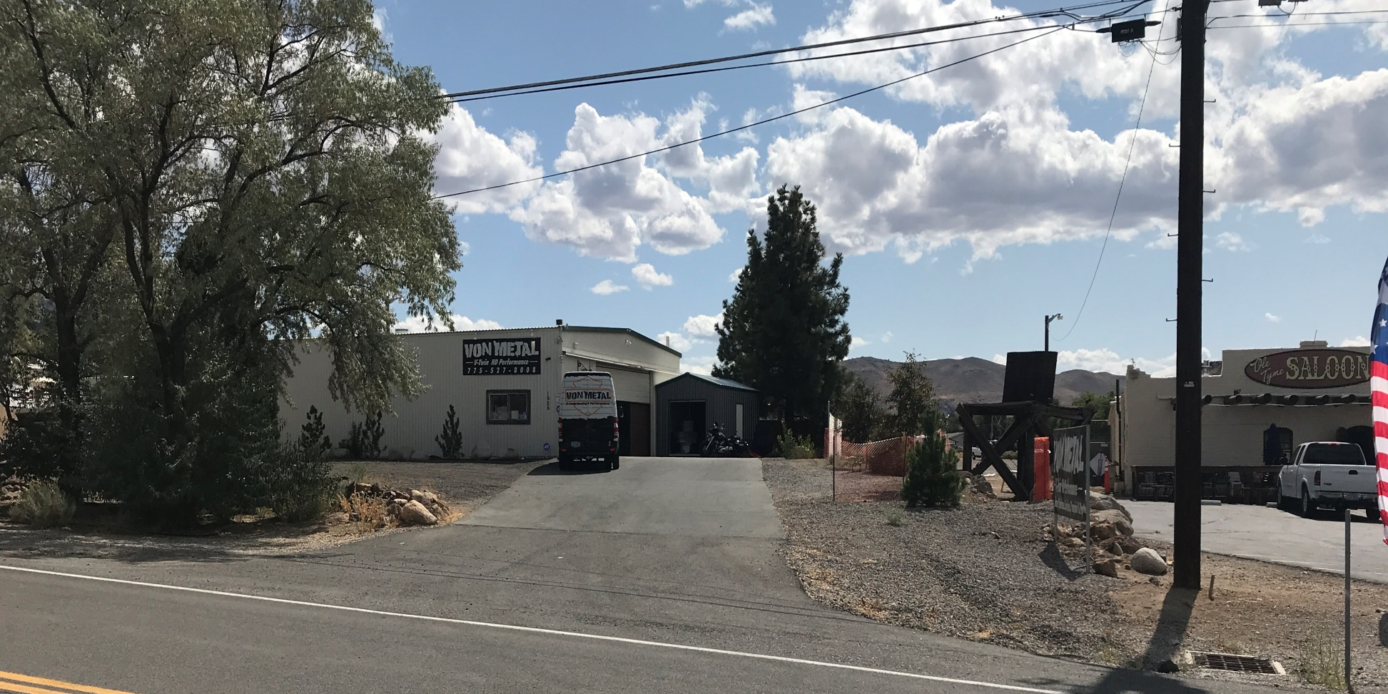
WSUP19-0018 Foothill Storage
Washoe County Board of Adjustment
October 3, 2019

Slide 2
Request
The request is for a special use permit (SUP) to allow for the use of storage of operable vehicles at 1525 Geiger Grade
The applicant is also asking to modify the parking standards and not pave the area where the vehicles are stored

Slide 3
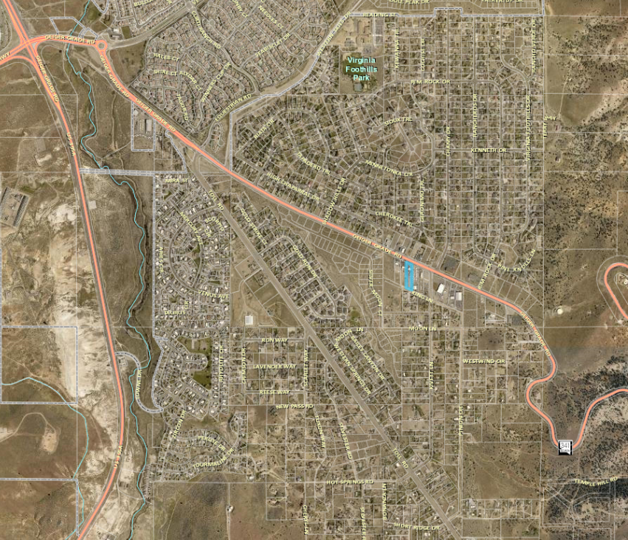
Project Site

Slide 4
Background
The property has a regulatory zoning of General Commercial (GC)
The parcels to the east and west of the site have regulatory zoning of General Commercial (GC)
The parcels north and south of the site have regulatory zoning of Medium Density Suburban (MDS)

Slide 5
Background
The applicant has an existing licensed business for the storage of operable vehicles on the adjacent parcel APN: 017-051-05, 1545 Geiger Grade
The applicant is doing business at 1524 Geiger Grade and there is a current code case on the property
The approval of the SUP will allow the property owner to apply for a business license

Slide 6
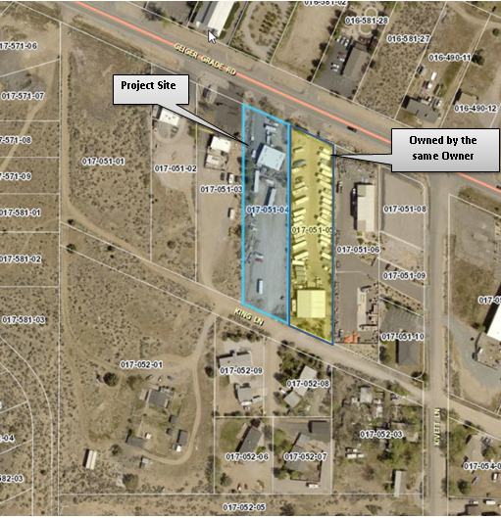

Slide 7
Analysis
The applicant is proposing to have 40 spaces
That the site has stated that 9,500 sq. ft. of the 43,393 sq. ft. site is landscaped , which meet the 20% requirement
The applicant is requesting to continue to use King Lane as the entrance to the site and exit on Geiger Grade
King Lane is a dirt road and considered an unimproved access easement and the County has not accepted the roadway

Slide 8
Analysis
Staff is recommending that the site be access from Geiger Grade and that King Lane is gated as a secondary access
Or the applicant will need to meet to minimum public or private street standards in accordance with Article 110. 436 Street Design Standards to use King Lane for access

Slide 9
Analysis
The applicant is requesting to modify the parking requirement WCC 110.410.25(e) and not pave the site but use a gravel material where vehicles are stored
Staff is recommending that all driveways and roadways on the site be paved and where vehicles are stored with engines the parking spaces be paved and other parking spaces may be graveled

Slide 10
Public Notice & CAB
Public notice was sent to parcels within 500 feet from the site
The South Truckee Meadows/Washoe Valley CAB reviewed the application on September 5, 2019 and recommended to approve the application

Slide 11
Reviewing Agencies
Various agencies reviewed the application, their comments are included in the staff report
Agencies with conditions, are included in the Conditions of Approval

Slide 12
Findings
1. Consistency.
2. Improvements.
3. Site Suitability.
4. Issuance Not Detrimental.
Effect on a Military Installation.
Staff is able to make all the required findings, as detailed in the staff report

Slide 13
Special Use Motion
I move that, after giving reasoned consideration to the information contained in the staff report and information received during the public hearing, the Washoe County Board of Adjustment approve with conditions Special Use Permit Case Number WSUP19-0018 for Mark & Melanie Hain, having made all five findings in accordance with Washoe County Code Section 110.810.30

